Slide 1
Mumbai University Pre-Admission Online Registration Process for Student: Tutorial

Slide 2
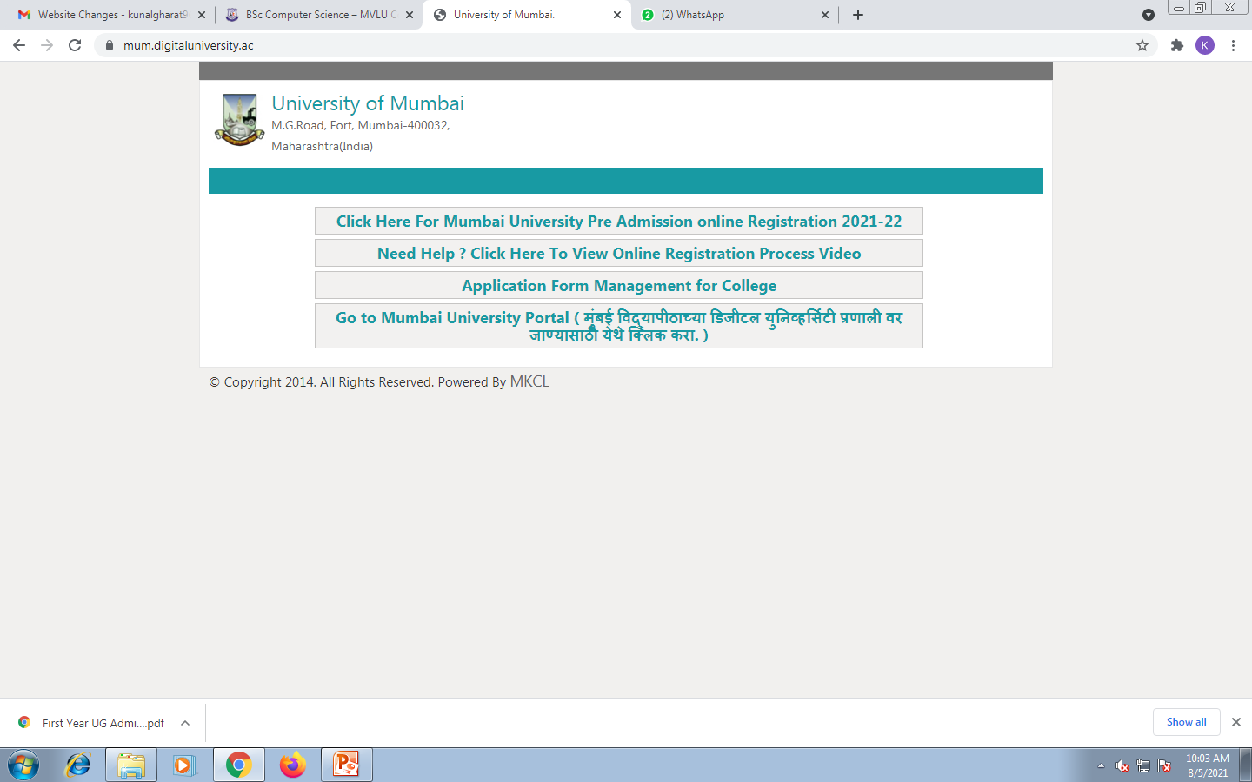
Visit on mum.digitaluniverisity.ac & Click on Pre-Admission Online Registration for AY 2021-22

Slide 3
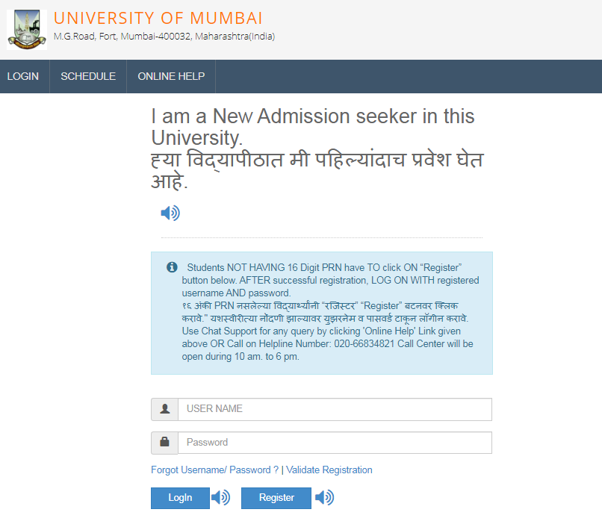
Registration Process for Login Details
Click on Register

Slide 4
Registration Process for Login Details
After Fill the details click on Accept

Slide 5
Registration Process for Login Details
After read the instructions, click here

Slide 6
Registration Process for Login Details
Click on Register

Slide 7
Registration Process for Login Details
User Name and OTP received via SMS type OTP then click on Verify

Slide 8
Confirmation of Registration
Set new password then click here

Slide 9
Login with change password
Click here

Slide 10
Pre-Admission online application process
Click here

Slide 11
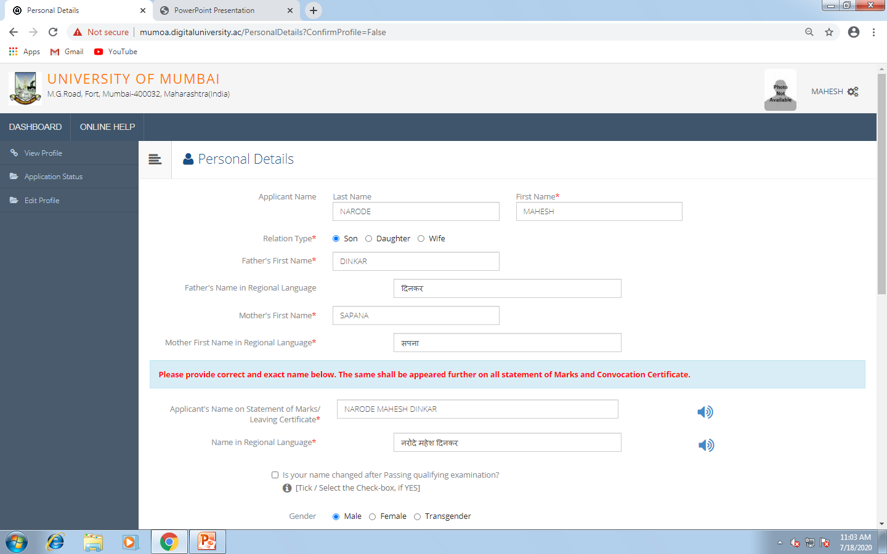
Enter Personal Details Process

Slide 12
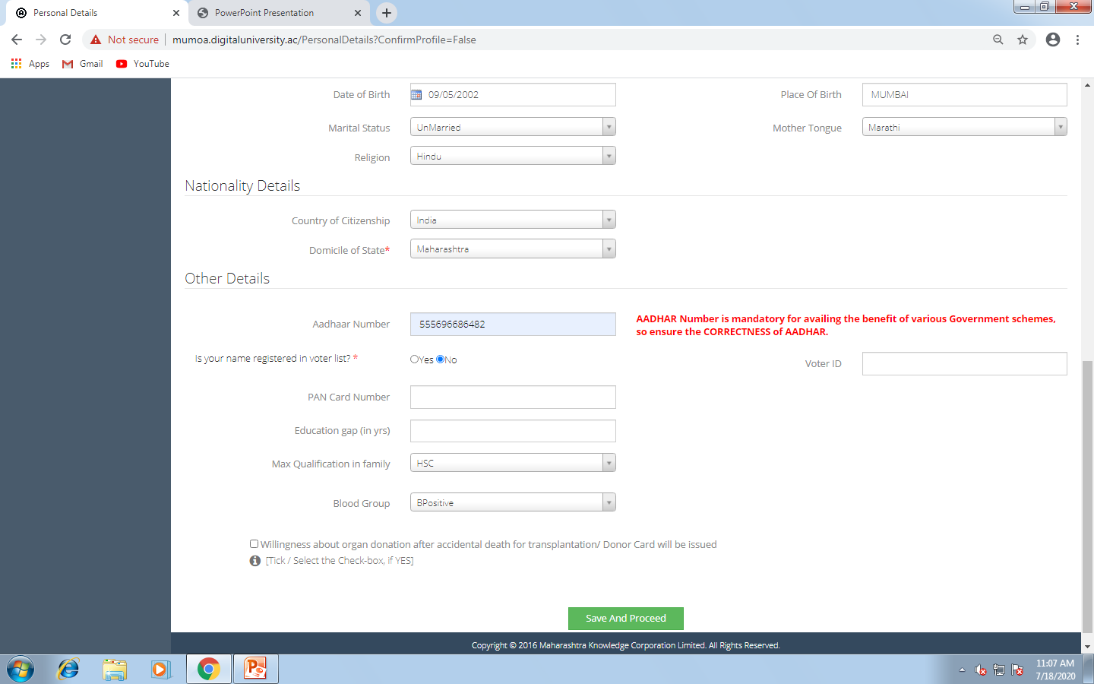
Enter Personal Details Process
Click here

Slide 13
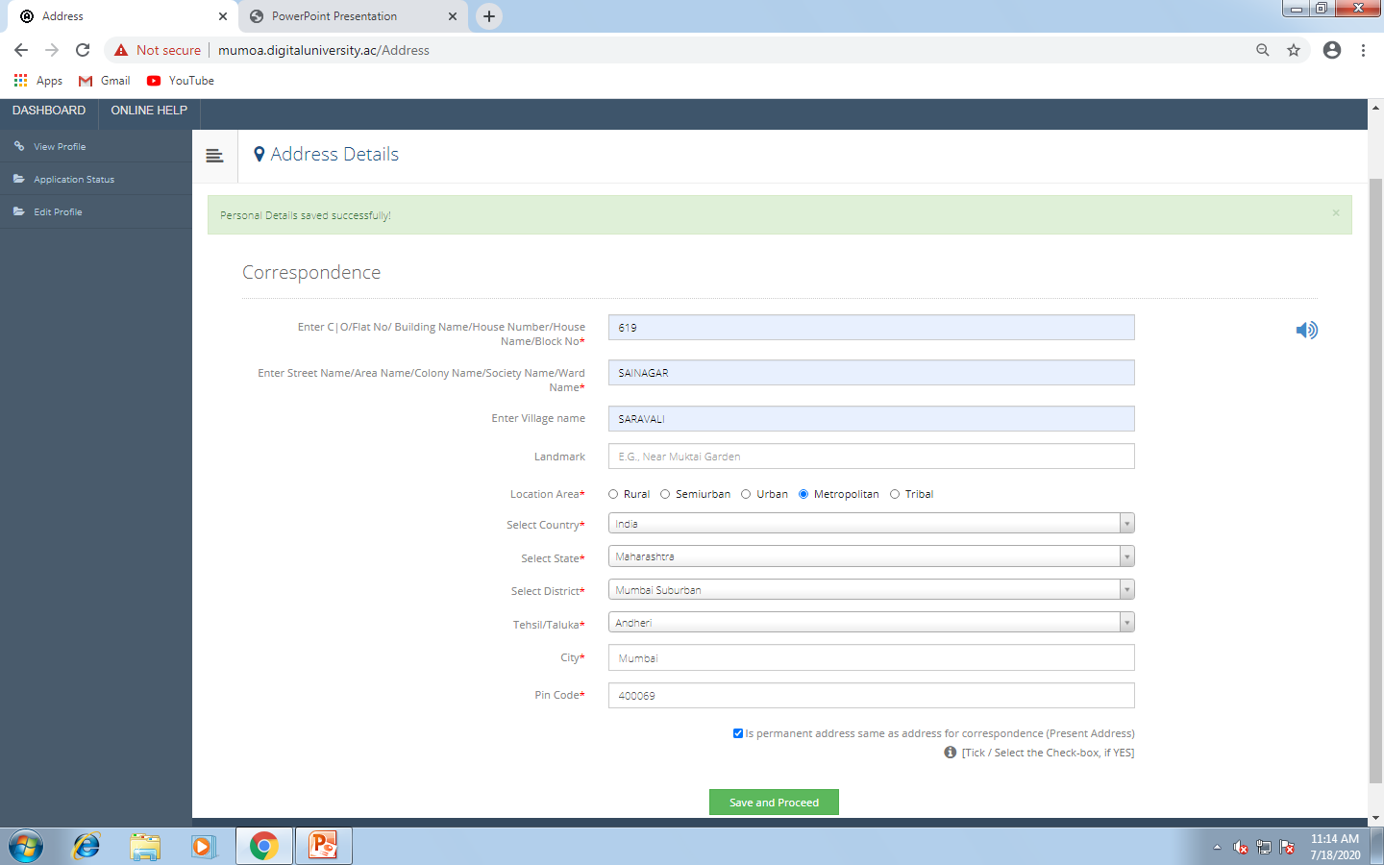
Address Details
Click here

Slide 14
Enter Educational Details
Click here to add SSC details

Slide 15
Enter the details of S.S.C Examination
Click
here

Slide 16
Enter Educational Details
Click here to add HSC details

Slide 17
Enter the details of H.S.C Examination

Slide 18
H.S.C Examination Details Saved
Click on proceed

Slide 19
Enter Reservation Details
Click here

Slide 20
Photo & Sign Upload Process
Browse the photo image

Slide 21
Photo upload process
Crop the image and click on upload

Slide 22
Signature upload process
Click on signature and browse the sign image

Slide 23
Signature upload process
Crop the image and click on upload

Slide 24
Photo & Signature process completed
Click on proceed

Slide 25
Enter contact details
Click here

Slide 26
When a profile is completely filled all the profile fields will show a “ Check Mark” indicating that information is duly filled.
Click here

Slide 27
Confirmation of profile
If edit profile, click here
Check all the detail before confirm profile then click here

Slide 28
Course Selection Process
For computer science course type comp in find
To apply in Computer Science course click here

Slide 29
Eligibility Criteria
Click here

Slide 30
Select Last Qualifying Exam
Select HSC/12th
Click here

Slide 31
College Selection Process
For MVLU college type 199 in find
Click here

Slide 32
Paper Selection Process SEM I
Click here

Slide 33
Paper Selection Process
Click here

Slide 34
Paper Selection Process SEM II
Click here

Slide 35
Paper Selection Process completed
Click here

Slide 36
Document Submitting Selection Process

Slide 37
Documents/Certificates uploading process
Upload all documents then click on proceed

Slide 38
Print application form process
Click here

Slide 39
Print e-Suvidha Ticket
Click here

Slide 40
e-Suvidha Ticket

Slide 41
Print or Save e-Suvidha Ticket for Verification Code
Click here to save as pdf

Slide 42
After Print or Save Verification Code Available on the e-Suvidha Ticket
Verification code

Slide 43
Print Application form
Print or save this form for submit with pre-merit form

Slide 44
Application Status

Slide 45
Online Application Process Completed

